Slide 1
HDL Part VI
陳培殷
國立成功大學 資訊工程系

Slide 2
Sequential Circuit (1/2)
A sequential circuit is a system whose outputs at any time are determined from the present combination of inputs and the previous inputs or outputs.
Combinational
Logic Circuit
m output
variables
n input
variables
..
..
Memory
Elements
states
Sequential components contain memory elements
The output values of sequential components depend on the input values and the values stored in the memory elements
Example: Ring counter that starts the answering machine after 4 rings

Slide 3
Sequential Circuit (2/2)
Sequential components can be: asynchronous or synchronous
Asynchronous sequential circuit:
Change their states and outputs whenever a change in inputs occurs
Synchronous sequential circuit:
Change their states and outputs at fixed points of time (specified by clock signal)
Most circuits are synchronous circuits (easy and tool-supportable).
Synchronous storage components store data and perform some simple operations.
Synchronous storage components include: (1) registers (2) counters (3) register files (4) memories (5) queues (6) stacks

Slide 4
Clock Period
clock period
clock
width
rising edge
falling edge
Clock period (measured in micro or nanoseconds) is the time between successive transitions in the same direction
Clock frequency (measured in MHz or GHz) is the reciprocal of clock period
Clock width is the time interval during which clock is equal to 1
Duty cycle is the ratio of the clock width and clock period
Clock signal is active high if the changes occur at the rising edge or during the clock width. Otherwise, it is active low

Slide 5
Latch and Flip-Flop
rising
edge
falling
edge
Latches are level-sensitive since they respond to input changes during clock width. Latches are difficult to work with for this reason.
Flip-Flops respond to input changes only during the change in clock signal (the rising edge or the falling edge).
They are easy to work with though more expensive than latches.
Two basic styles of flip-flops are available: (1) master-slave (2) edge-triggered

Slide 6
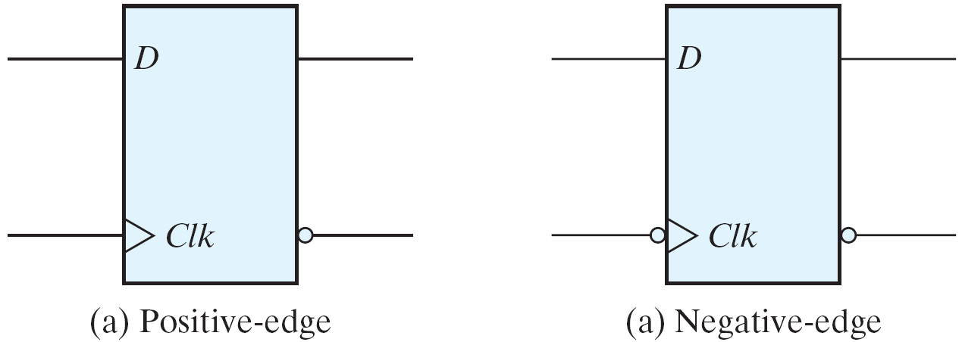
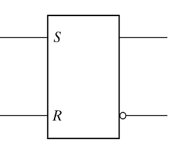
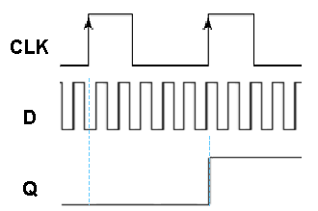
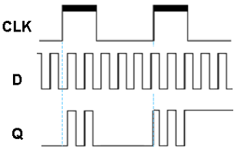
Latch vs. Flip-Flop
Level triggered
Edge triggered
positive-edge triggered
Latch
negative-edge triggered
CLK
Q
D
Q
CLK
CLK

Slide 7
Flip-Flop Inference
module D_FF(Clk, D, Q);
input Clk, D;
output Q;
Reg Q;
always @(negedge Clk)
begin
Q=D;
end
endmodule
D | Q_{(t+1)}
0 | 0
1 | 1
At every negative edge
of Clk, Q is set as D
clock period
D Flip-flop
module D_FF(Clk, D, Q);
input Clk, D;
output Q;
Reg Q;
always @(posedge Clk)
begin
Q=D;
end
endmodule
D Q
Clk
rising edge
falling edge
module Toggle (Clk, Q);
input Clk;
output Q;
Reg Q;
always @(posedge Clk)
begin
Q=~Q;
end
endmodule
Toggle Flip-flop
At every positive edge
of Clk, Q is set as D
D Q
Clk

Slide 8
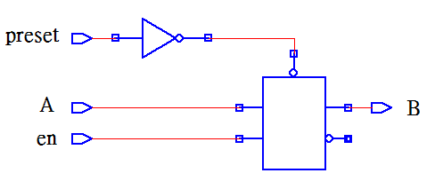
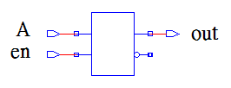
Watch Out for Unintentional Latches (1/3)
module latch_if1(en,A,out);
input en, A;
output out;
reg out;
always @(en)
begin
if(en)
out = A;
end
endmodule
module latch_4(en, preset, A, B);
input en, preset, A;
output B;
reg B;
always @(en or preset or A)
begin
if(preset)
B = 1;
else if(en)
B = A;
end
endmodule
If en ==1 out = A
else out (new) = out (old)

Slide 9
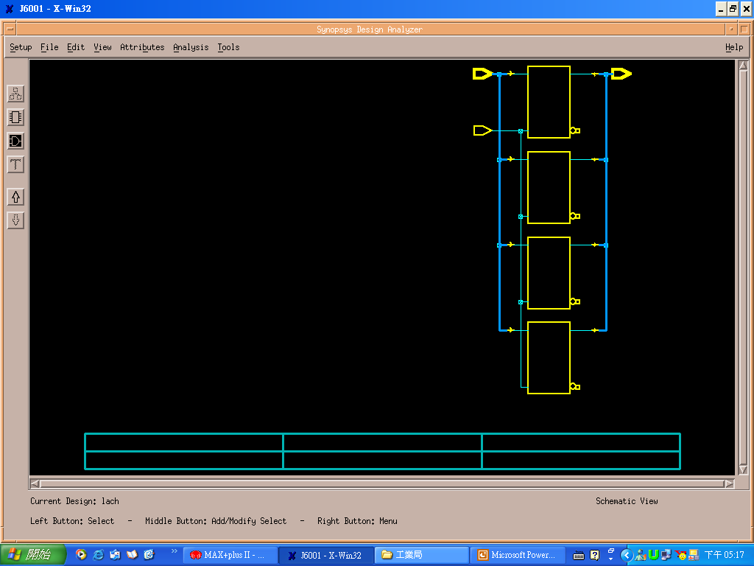
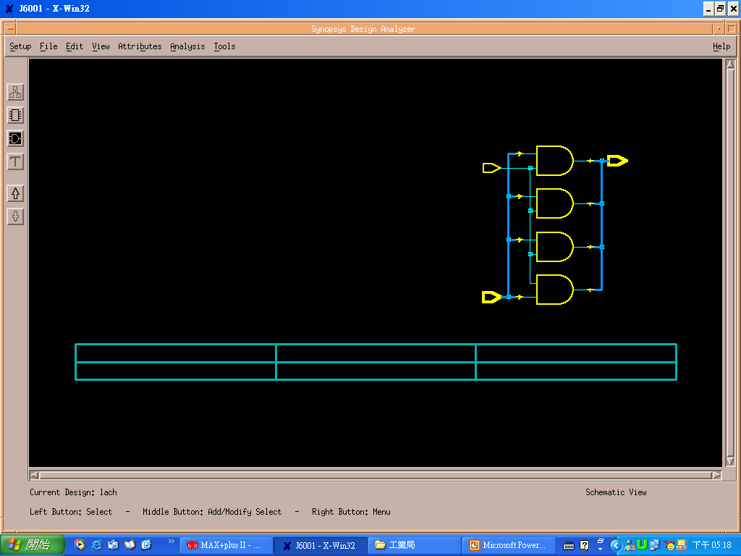
Watch Out for Unintentional Latches (2/3)
Module Latch(In, Enable, Out);
input Enable;
input [3:0] In;
output [3:0] Out;
always @(In or Enable)
begin
if(Enable)
Out=In;
end
endmodule
Module Latch(In, Enable, Out);
input Enable;
Input [3:0] In;
output [3:0] Out;
always @(In or Enable)
begin
if(Enable)
Out=In;
else
Out=0;
end
endmodule
Out=0;
if(Enable)
Out=In;
No latch inference
If Enable ==1
Out (new) = In
If Enable==0
Out (new) = Out (old)

Slide 10
Watch Out for Unintentional Latches (3/3)
Watch Out for Unintentional Latches
Completely specify all clauses for every case and if statement
Completely specify all output for every clause of each case or if statement
Fail to do so will cause latches or flip-flops to be synthesized
Always @ (d) begin
cased (d)
2’b00: z = 1’b0;
2’b01: z = 1’b0;
2’b10: ;
endcase
end
Missing Outputs
Missing Case

Slide 11
Synchronous/Asynchronous Counter
Synchronous counter:
All flip-flops in a synchronous counter receive the same clock pulse and so change state simultaneously.
Asynchronous (Ripple) counter:
Flip-flops transitions ripple through from one flip-flop to the next in sequence until all flip-flops reach a new stable value (state). Each single flip-flop stage divides the frequency of its input signal by two.
S_C
AS_C
0 0 0 0
0 0 0 1
0 0 1 0 …

Slide 12
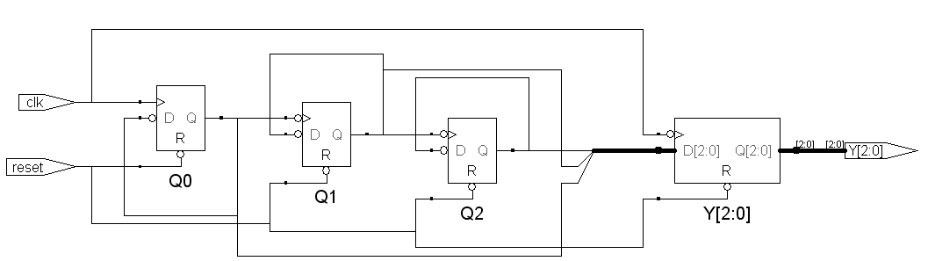
Counter Implementation
Synchronous counter
C(old) C(new)
0 0 0 0 0 1
0 0 1 0 1 0
0 1 0 0 1 1
….
1 1 0 1 1 1
1 1 1 0 0 0
combinational
C[2]
C[1]
C[0]
clk
reset
Asynchronous counter

Slide 13
Synchronous Counter(1/3)
module Counter1(Reset, Enable, clk, Out);
input Reset, Enable, clk;
output [2:0] Out;
reg [2:0] Out;
always @(posedge clk)
begin
if(Reset)
begin
Out = 3'b0;
end
else
if(Enable == 1'b1)
begin
if(Out == 3'd7)
Out = 3'b0;
else
Out = Out + 1'b1;
end
end
endmodule
What happens
if Out== 3'd5 ??
3
+
1
Out
clk
Reset=1 Out=000
Reset=0, Enable==1, Out=0 ➔1➔2➔3➔4➔5➔6➔7➔0➔1➔…..

Slide 14
Synchronous Counter (2/3)
module Counter2 (clk, Reset, Load, Enable, Data_In, Out);
input clk, Reset, Load, Enable;
input [7:0] Data_In;
output [7:0] Out;
reg [7:0] Out;
always @ (posedge clk)
begin
if (Reset)
Out = 0;
else
if (Load)
Out = Data_In;
else
if (Enable)
Out = Out + 1;
end
endmodule
Reset=1 Out=00000000
Reset=0, Load=1, Out=Data_In
Enable==1, Out=x ➔x+1➔…..➔255➔0
➔1➔……➔255➔0➔…
Out(old)
0
1
Out+1
0
1
Data_In
0
1
Out
0
Enable
Load
Reset

Slide 15
Synchronous Counter(3/3)
module Counter6 (clk, Reset, Load, Enable, Up_Down, Data_In, Out);
input clk, Reset, Load, Enable, Up_Down;
input [7:0] Data_In;
output [7:0] Out;
reg [7:0] Out;
always @ (posedge clk)
begin
if (Reset)
Out = 0;
else
if (Load)
Out = Data_In;
else
if (Enable)
begin
if (Up_Down)
Out = Out + 1;
else
Out = Out - 1;
end
end
endmodule
If down-by-two
Out=Out-2;

Slide 16
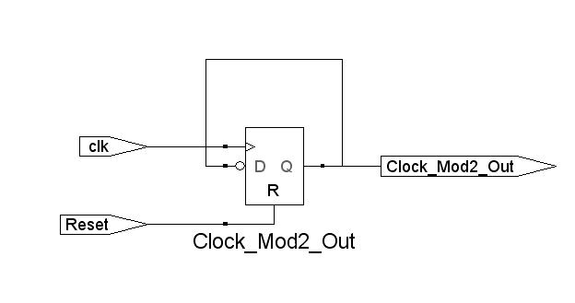
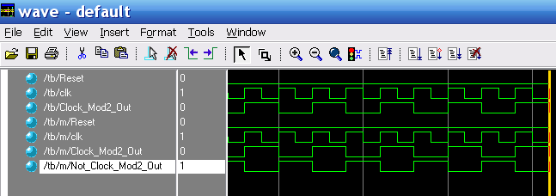
Asynchronous Counter(1/5)
module FreqMod2 (Reset, clk_In, clk_Mod2_Out);
input Reset, clk_In; output clk_Mod2_Out;
reg clk_Mod2_Out; wire Not_clk_Mod2_Out;
assign Not_clk_Mod2_Out = !clk_Mod2_Out;
always @(posedge Reset or posedge clk_In)
begin
if (Reset) clk_Mod2_Out = 0;
else clk_Mod2_Out = Not_clk_Mod2_Out;
end
endmodule
Each single flip-flop stage divides the frequency of its input signal by two.

Slide 17
Asynchronous Counter(2/5)
always@(posedge div4 or negedge reset)
if(!reset)
div8=0;
else
div8=!div8;
always@(posedge div8 or negedge reset)
if(!reset)
div16=0;
else
div16=!div16;
always@(posedge clk or negedge reset)
if(!reset)
Y=0;
else
Y=div16;
endmodule
Divide by 16 clock divider using an asynchronous (ripple) counter ➔frequency divider
Count-down counter
module CNT_ASYNC_CLK_DIV16(clk,reset,Y);
input clk,reset; output Y;
reg div2,div4,div8,div16, Y;
always@(posedge clk or negedge reset)
if(!reset)
div2=0;
else
div2=!div2;
always@(posedge div2 or negedge reset)
if(!reset)
div4=0;
else
div4=!div4;

Slide 18
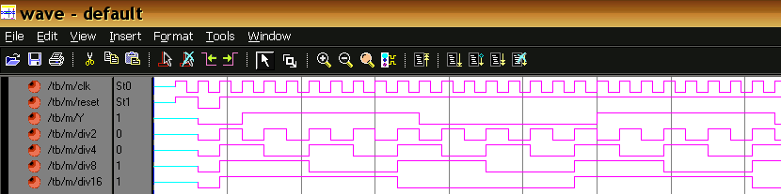
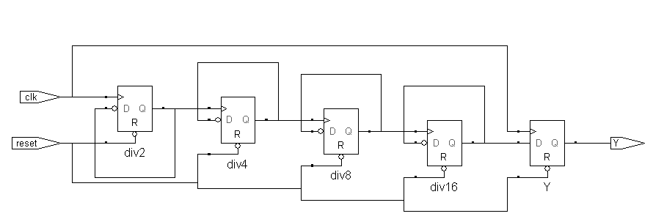
Asynchronous Counter(3/5)
0 1 2 3 4 5 6 7 8 9 10 1112 13 1415 0
15 14 13 12 11
1 0 15 1413
Count-down counter 15➔14➔13➔…….1➔0➔15➔14➔…..

Slide 19
Asynchronous Counter(4/5)
always@(posedge div4_b or
negedge reset)
if(!reset)
div8=0;
else div8=!div8;
assign div8_b=!div8;
always@(posedge div8_b or
negedge reset)
if(!reset)
div16=0;
else
div16=!div16;
always@(posedge clk or
negedge reset)
if(!reset)
Y=0;
else
Y=div16;
endmodule
Count-up counter
module DIV16(clk,reset,Y);
input clk,reset; output Y;
reg div2,div4,div8,div16, Y;
always@(posedge clk or negedge reset)
if(!reset)
div2=0;
else
div2=!div2;
assign div2_b=!div2;
always@(posedge div2_b or negedge reset)
if(!reset)
div4=0;
else
div4=!div4;
assign div4_b=!div4;

Slide 20
Asynchronous Counter(5/5)
always@(posedge div2 or negedge
reset or posedge clear)
if(!reset)
div4=0;
else if(clear)
div4=0;
else
div4=!div4;
assign div4_b =!div4;
always@(posedge div4 or negedge
reset or posedge clear)
if(!reset)
div8=0;
else if(clear)
div8=0;
else
div8=!div8;
assign div8_b=!div8; … .
Divide by 13 clock divider using an asynchronous (ripple) counter
module CNT_ASYNC_CLK_DIV13(clk,reset,Y);
input clk,reset; output Y;
reg div2,div4,div8,div16,Y;
wire div2_b,div4_b,div8_b,div16_b,clear;
always@(posedge clk or negedge reset
or posedge clear)
if(!reset)
div2=0;
else if(clear)
div2=0;
else
div2=!div2;
assign div2_b=!div2;

